Slide 1
Portable Nutrient Data Collection System
May1719
Dr. Daji Qiao – Advisor
Dr. Long Que - Client
Ben Theisen – Team Leader
Michael Rupert – Web Master
Ben Engebrecht – Communication Lead
Logan Boas – Communication Lead #2
Zakk Belloma – Key Concept Holder
Ryan Young – Key Concept Holder #2

Slide 2
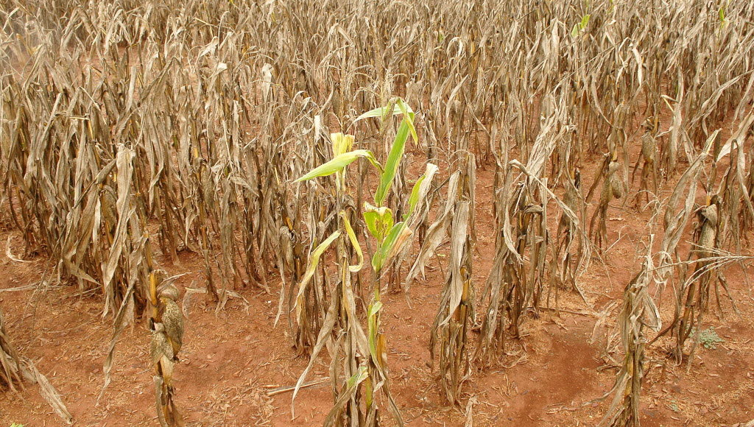
Problem
Chemicals in water sources can cause damage
Environmentally
Potentially caused by pollution
Harmful to humans and animals
Agriculturally
Unhealthy crops
Could possibly kill crops
Notes:
Ben T
Chemicals can cause harm in many different environments to humans, animals, and plants
Environmentally,
Pollution can cause harm to animals and plants, potentially killing them off. This can prove to be a problem if endangered species are affected, or even simply if livestock were to be affected.
Agriculturally
Chemicals can damage or possibly even kill crops. This can lead to farmers losing out on income, or even unhealthy crops getting to peoples homes.
If unhealthy crops get to peoples homes and they consume them, this could lead to health problems.

Slide 3
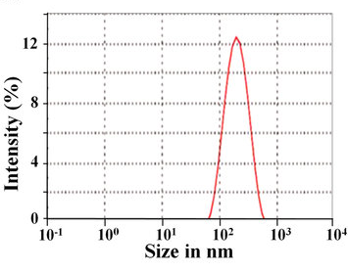
Project Description
Portable system to analyze water samples
Combines a hardware system with an Android app
Meant to be used in the field
Intensity vs Wavelength graph
Notes:
Ben T
So, the intention of this project was to help mitigate those risks that chemicals in various environments.
Being able to analyze water samples in the field can provide the user with an idea of what they are dealing with.
In order to analyze water samples, we needed to combine a hardware system with an smartphone application. We choose to develop our application for Android because we had group member that had developed for Android before.
Both system used together are meant to be used in the field. This can provide a user such as a farmer,
or an environmental agency to gather data at the source of a problem eliminating time needed to
transfer samples to a lab for analysis.

Slide 4
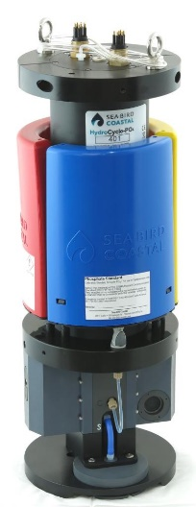
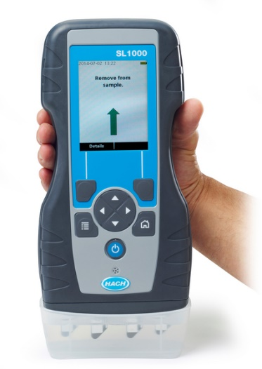
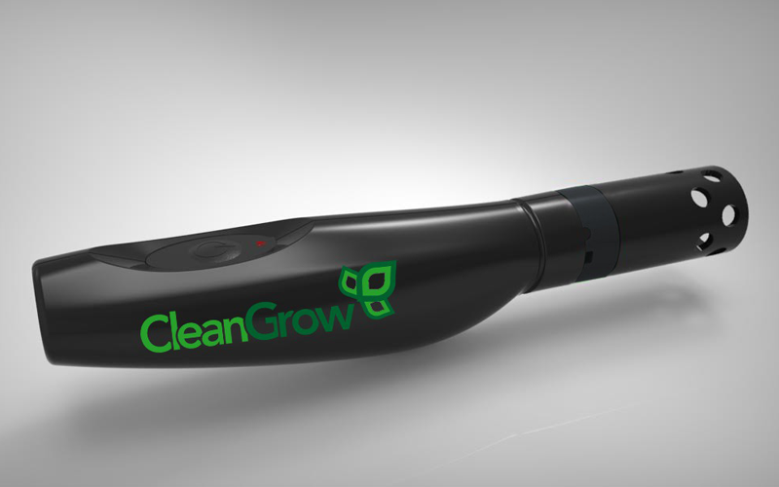
Market Survey
HydroCycle-PO4 Phosphate Sensor
SL1000 Portable Parallel AnalyzerTM
CleanGrow – Nutrient Analyzer
Notes:
BenT
HyrdroCycle-P04 Phosphate Sensor
Very bulky, Almost 2 feet tall
At less than a pound, weight is not a huge issue, but the size makes it less portable
Can only test for phosphate
SL1000
Requires consumable strips for sample testing
Clean Grow - Nutrient Analyzer
- Only has 6 sensors capable of detecting nutrients/chemicals
If the user needs to detect a certain chemical that is not among those 6, then they are out of luck
- Less room for customizability depending on the task of the user.

Slide 5
Functional Requirements
Weatherproof/Weather resistant
Wireless connectivity for data transfer
Store sample data in a database
Able to perform multiple tests
Display data in human readable fashion
Notes:
Weatherproof/Resistant
-The system is intended to be used in the field, specifically around water so it will need to be waterproof
Wireless connectivity
-Wireless connectivity reduces the number of things needed in the field to operate the system.
If a wire was needed, and forgotten, then the system would not be operable, so this eliminates
that potential problem
Storing data
-Sample data needs to be stored so that further analysis can be done later.
Multiple Tests
-The system should be capable of performing multiple tests without resetting the entire system.
(The water sample changed out, and then the test is ran again.)
Displaying data
- The spectrometer sends out pixel intensity information. Simply seeing a list of numbers would not
mean anything to the user, so this data needs to be displayed in a more meaningful fashion.

Slide 6
Non-Functional Requirements
App interface tutorial
Portable system
Battery should last for 50 trials or one full day
Reasonable wireless range
Runtime of less than five seconds
Notes:
Interface Tutorial
- A tutorial needs to be provided in order for the user to know how to operate the system. Combined with keeping the UI simple and meaningful allows for ease of use in the field.\
Portable System
-The entire system needs to be portable. If it is being used in the field, this could mean that the user
is walking with the system, so weight and size could be an issue.
Battery
-The battery used to power the system should last for 50 trials, or a full day in the field.
Reasonable wireless range
-Wireless connectivity to the system should be able to remain connected in a reasonable range.
A user will likely keep the system close to them in the field, so a reasonable range of 20 feet or better
Short runtime
-The entire run time of the system should take a small amount of time, so that if a sample contains a chemical the user is looking for, then they will not have to wait long to know they should continue to test that area.

Slide 7
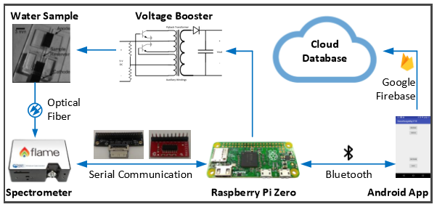
Functional Decomposition
Flame Spectrometer
Raspberry Pi Zero
Android App
Voltage Booster
Web Based Viewer

Slide 8
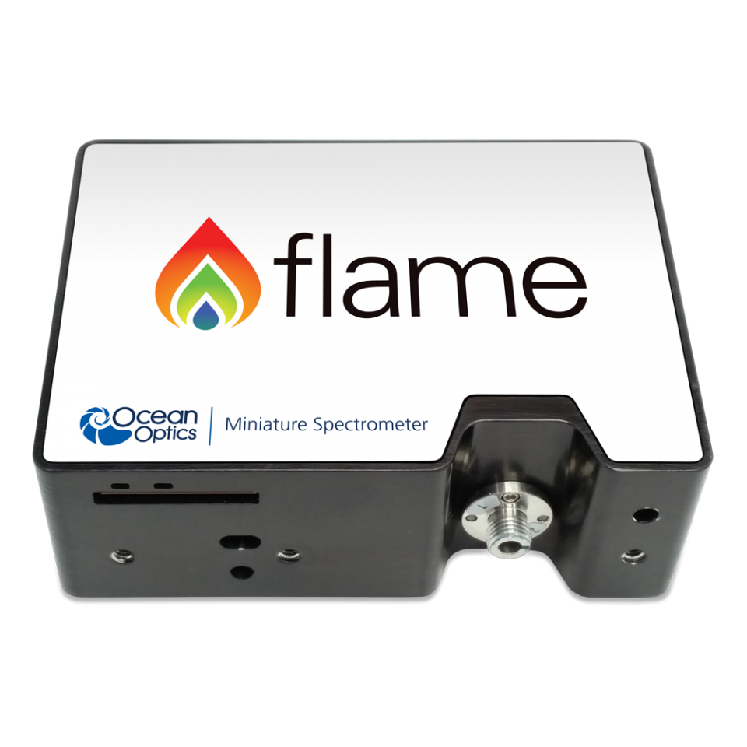
Spectrometer
3648 Pixels
350-1000 nm detection range
USB and RS232 communication
Small form factor
Optical imaging
Notes:
Differences between optical and mass spectrometers

Slide 9
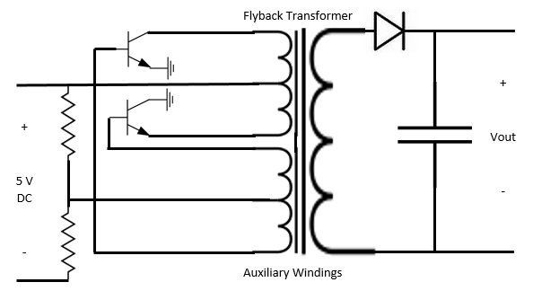
Voltage Booster
Turned on and off by using PWM GPIO pin of the Raspberry Pi and a NPN transistor.
Charges almost instantly.(Needs a minimum of 0.005 sec pulse to produce a spark)
Rated to convert 3.6 - 6 V DC to a maximum of 400 kV DC.
The output voltage is controlled by the air gap between the positive lead and path to negative lead. (larger the gap greater the voltage)
Smaller and cheaper than any other voltage booster we could find or design.
Flyback Converter Circuit

Slide 10
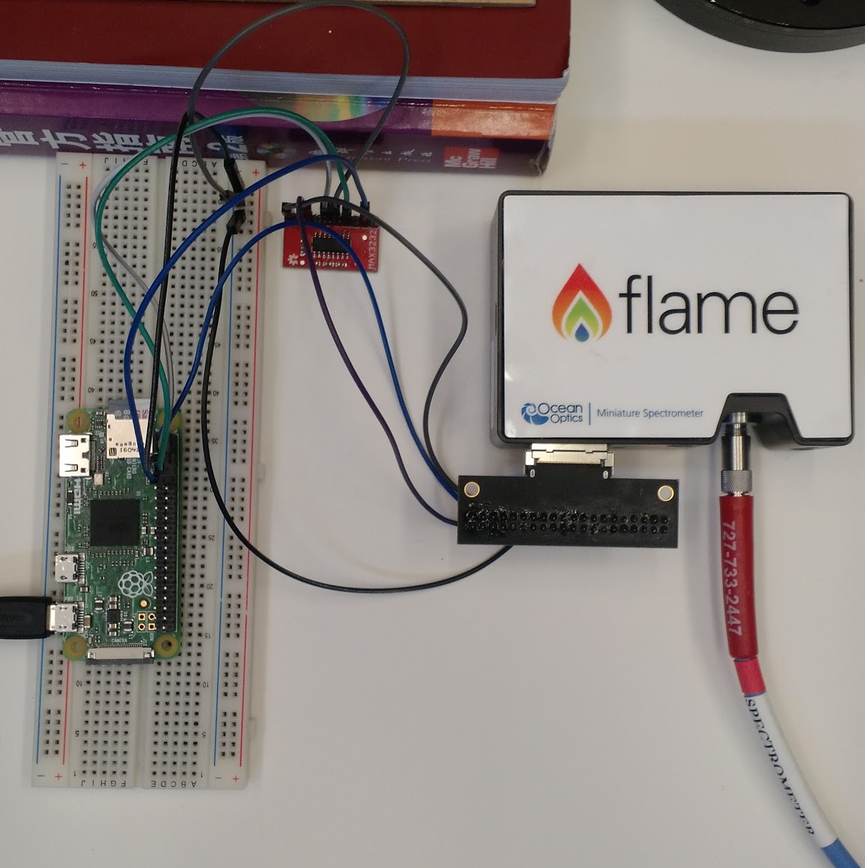
Physical System
Reads data from spectrometer scans
Sends data to Bluetooth device via Python
Server script handles connections and data transfer
LED’s indicate status while “headless”

Slide 11
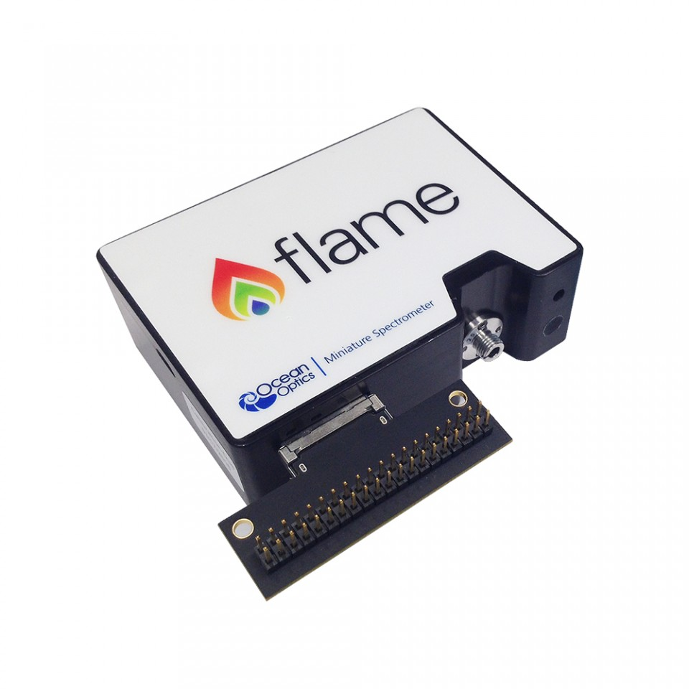
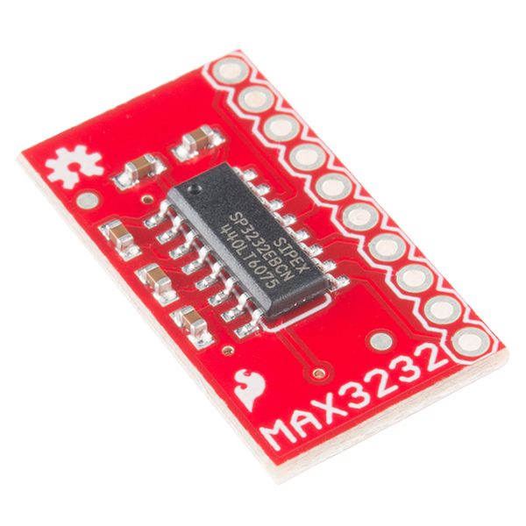
Serial Communication
Works with sending and receiving from the spectrometer
Control settings of the spectrometer
Uses Tx and Rx GPIO pins on the Raspberry Pi
Choose serial over USB communication
Voltage level shifting

Slide 12
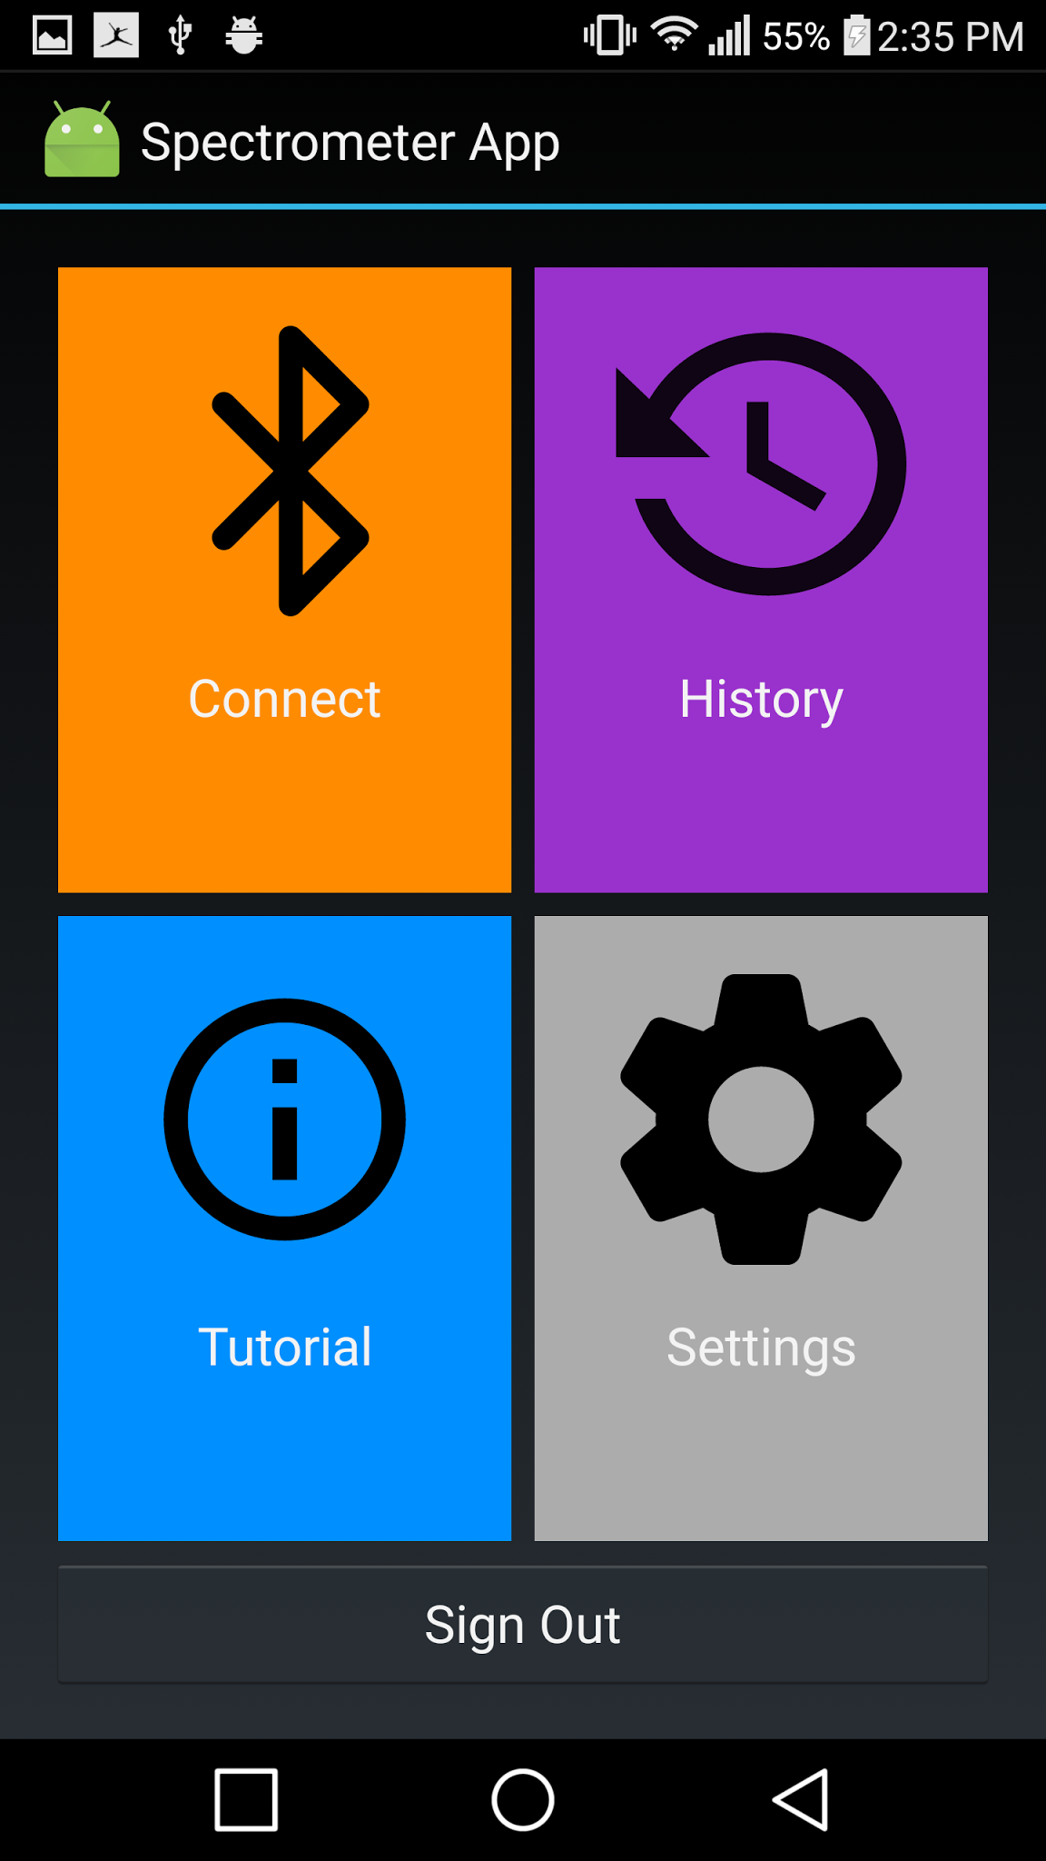
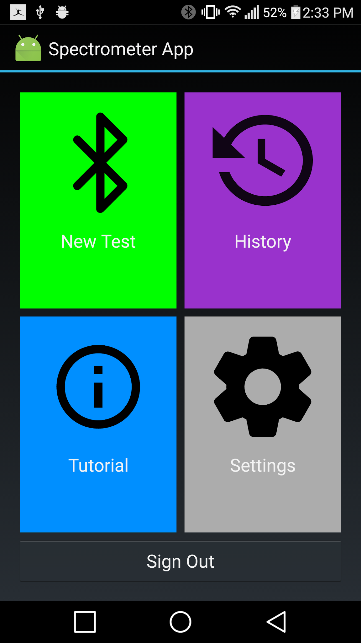
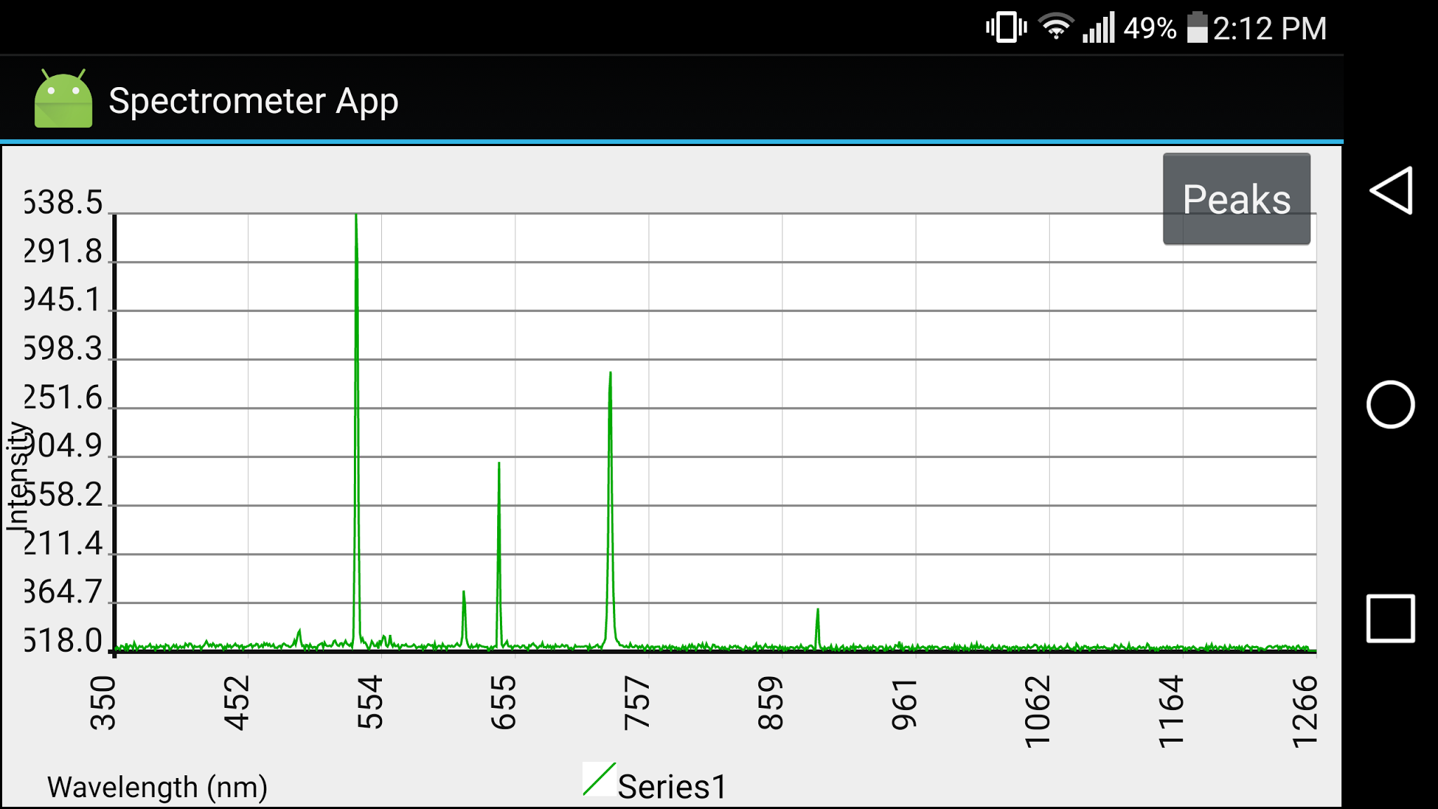
Android App
Uses bluetooth to connect to raspberry pi
Trigger scans from the app
Allows for data analysis in the field
Stores data in local and cloud database
Allows for viewing of each runs graph

Slide 13
Firebase
Stores scan data in a JSON-Formatted Database
Works locally first, but backs up to Google Cloud Services
Can be accessed from any type of software, such as Android, iOS, and Web

Slide 14
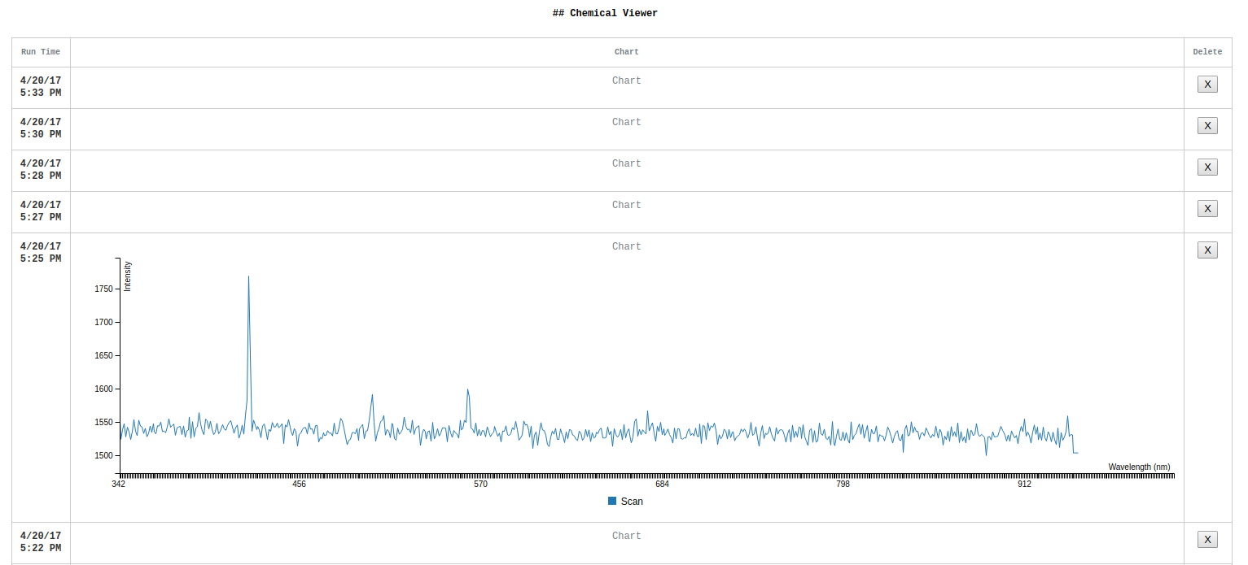
Web Viewer
Web based database graph viewer.
Live updates as new scan data is added from device.
Built with React JS

Slide 15
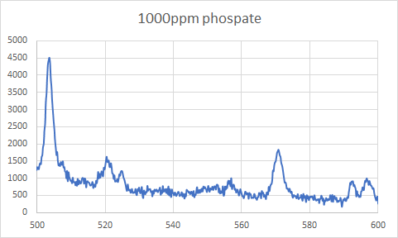
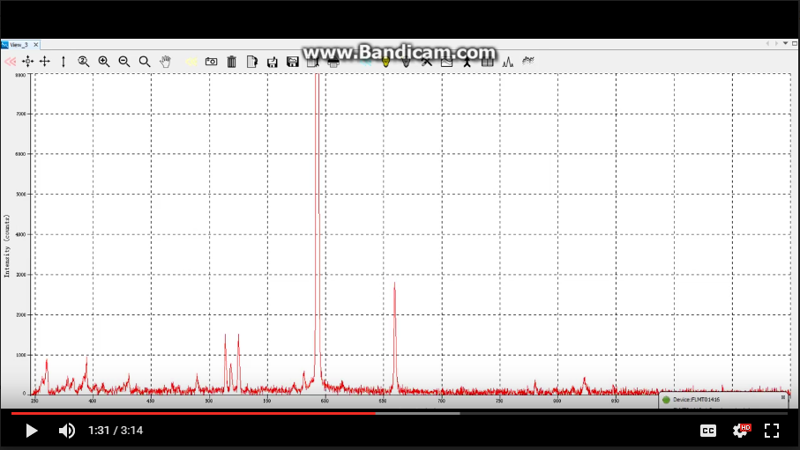
Testing
Results From Our System
Test each subsystem separately
Combined systems and test again
Test different samples with spectrometer
Test different voltages for voltage booster
Test different spectrometer settings
Results From Provided Software

Slide 16
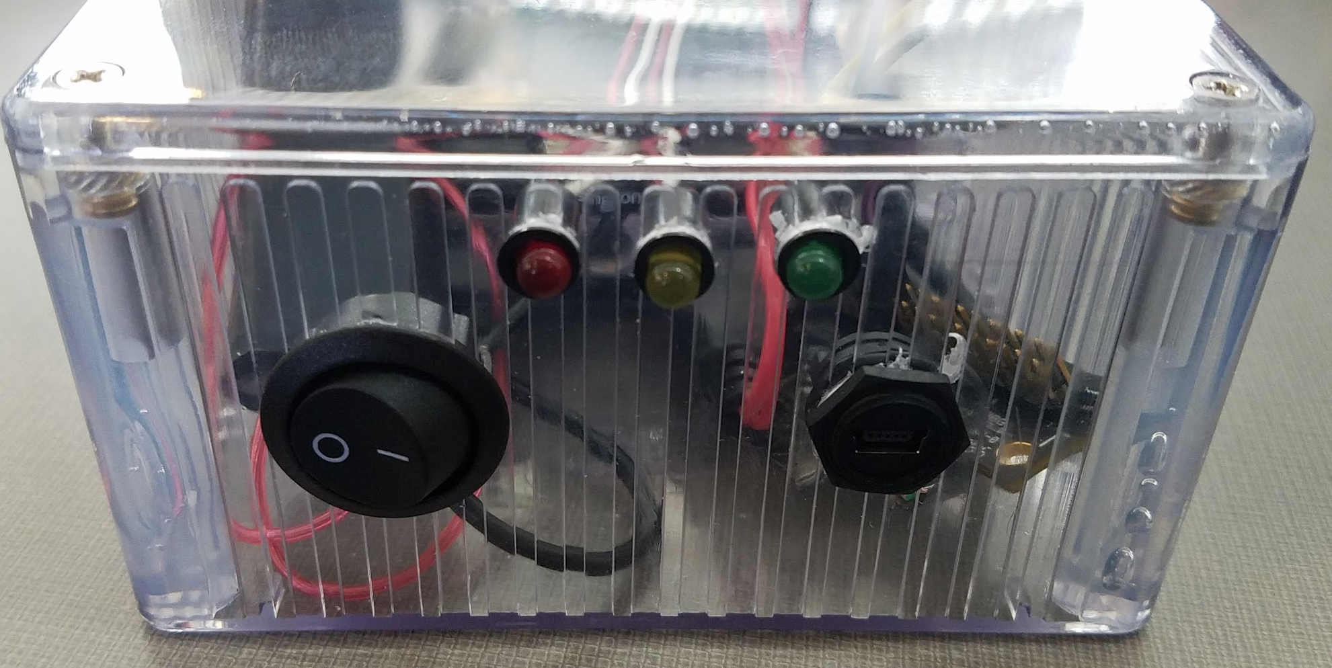
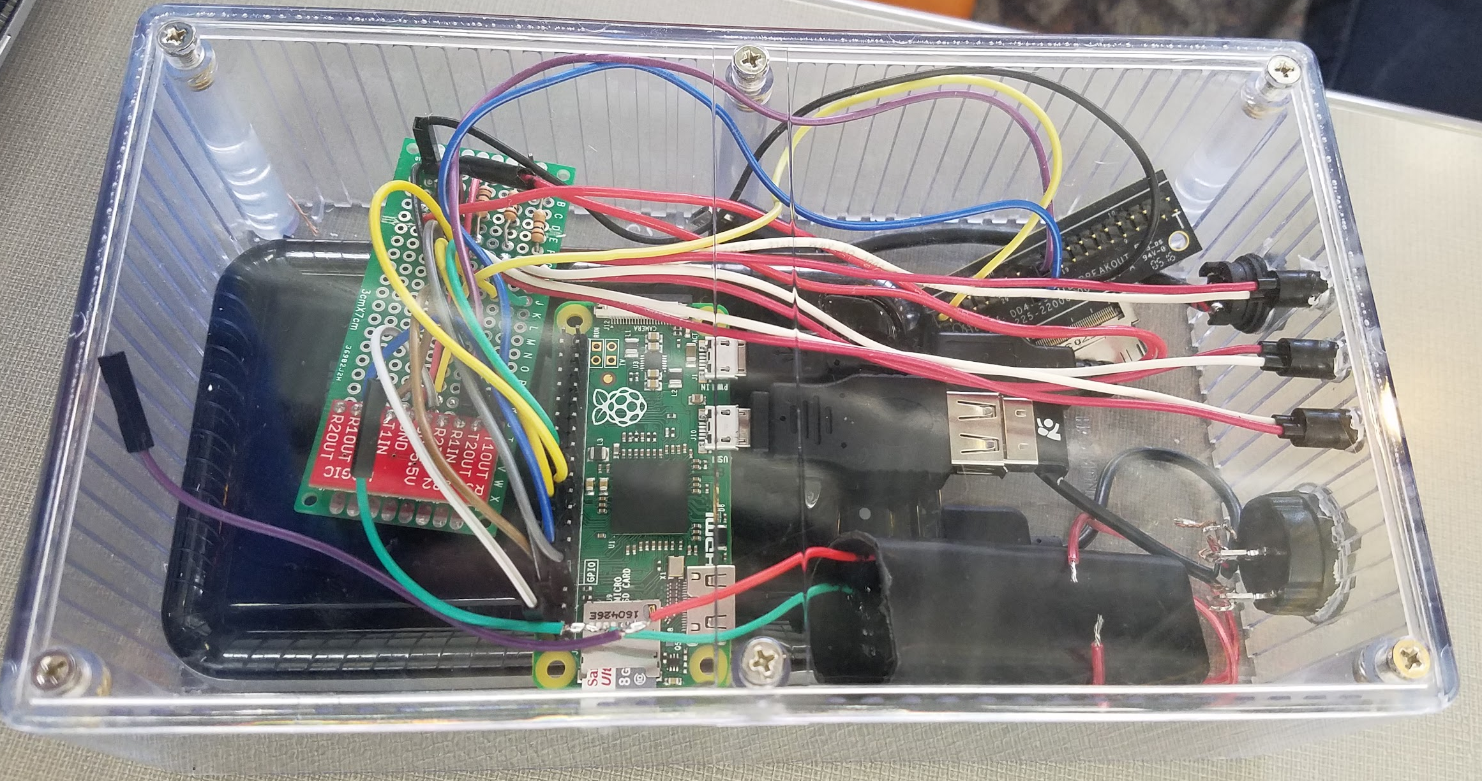
Enclosure
Dimensions: 7.48”x 4.33”x 2.38”
Charging port, power switch, and status LEDs mounted to side
Yellow - System is on
Green - Bluetooth connected
Red - Sample is being tested

Slide 17
Resource/Cost Estimate
Flame Spectrometer - $3,550.00
Break out board - $62.00
Raspberry Pi Zero kit - $24.95
Max3232 Level Shifter - $5.95
Voltage Booster - $2.44
Enclosure - $65.15
Total - $3710.49

Slide 18
Next Steps
Add app evaluation of spectrometer scans.
Make spectrometer settings fully functional
Obtain a fiber optic cable short enough to fit within the enclosure
Build in a separator between the spectrometer and the voltage booster to prevent any possible damage to spectrometer.
Create a system to hold sample which connects the voltage boosters leads to the cathode and anode of the water sample container, with the fiberoptic held at the optimum location
Perform more tests.

Slide 19
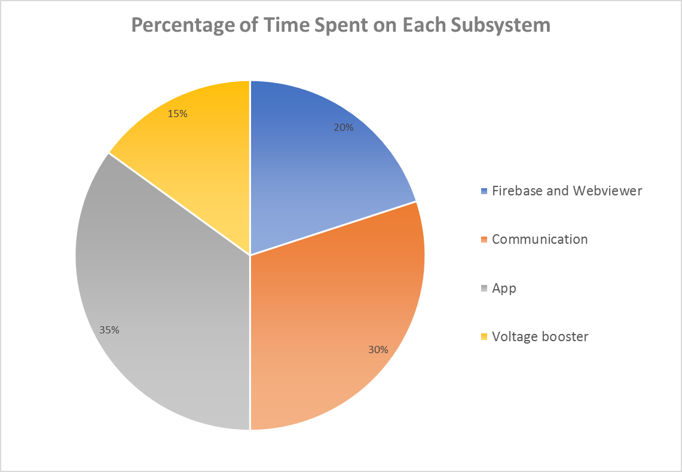
Work Division
Ben Theisen - App & Communication
Michael Rupert - Firebase & Web viewer
Ben Engebrecht- Communication
Zachary Belloma - App
Ryan Young - Communication & App
Logan Boas - Voltage Booster

Slide 20
Lessons Learned
We learned about:
Scheduling meetings around classes and work
Project planning and execution
Hardware not quite matching documentation
Interacting with an advisor and client

Slide 21
Overview

Slide 22
In Depth Serial Communication
•Pin connection: Rx -> Tx and Tx -> Rx at –6 to 6V on the spectrometer
•Need MAX3232 IC to convert between 0V to 3.3V TLL and -6V to 6V RS232
•Command format: ASCII character followed by data and character return
•Some commands don't pass data, these don't need character returns.
•Important commands:
•aA/ bB set data mode to ASCII or binary.
•K{Data Word}<CR>: set baud rate. -must be sent twice-
•S: acquire spectral data
•Flame Datasheet: http://oceanoptics.com/wp-content/uploads/FlameIO.pdf pg: 49-51, 106-116

Slide 23
In Depth App and Bluetooth
•App created in Android studio
•Currently targeting android 4.0 and above
•App request all required permissions to enable Bluetooth and then initiates connection.
•App sends commands to spectrometer over Bluetooth
•Receives spectrum data from spectrometer over Bluetooth

Slide 24
Web Viewer Technical Issues
Live Updating
Using React to retrieve and display data from Firebase
Graphing Data
Using JavaScript graphing framework to display data.
Parsing data into something that the graphing framework can use.

Slide 25
Physical Technical Issues
Raspberry Pi
Running “headless”
Debugging script on startup
Serial Communication
Wiring
Voltage levels

Slide 26
App Technical Issues
Bluetooth sockets
Creating a fallback socket for devices running newer bluetooth
Graphing Data
Parsing data from spectrometer into something meaningful

Slide 27
In Depth Voltage Booster
Actual circuit within voltage booster
Flyback transformer - has a built in auxiliary winding that acts like a switch that turns on when the magnetic field is at a certain level.
Transistors and resistors are used along with the auxiliary winding of the flyback transformer to change the current direction through the transformer.
When switched on the current and magnetic field are built up because voltage on secondary side is negative and is blocked by the diode
When Switched off the secondary voltage becomes positive and flows through the diode to the capacitor and load.
Voltage X-ray Images: Christian. (2015, January 16). [400kV Voltage Booster]. Retrieved March 25, 2017, from http://www.elektronaut.at/high-voltage-generator-from-ebay/645

